Slide 1
Correspondence analysis and redundancy analysis
Brittany Hupp
Week 7

Slide 2
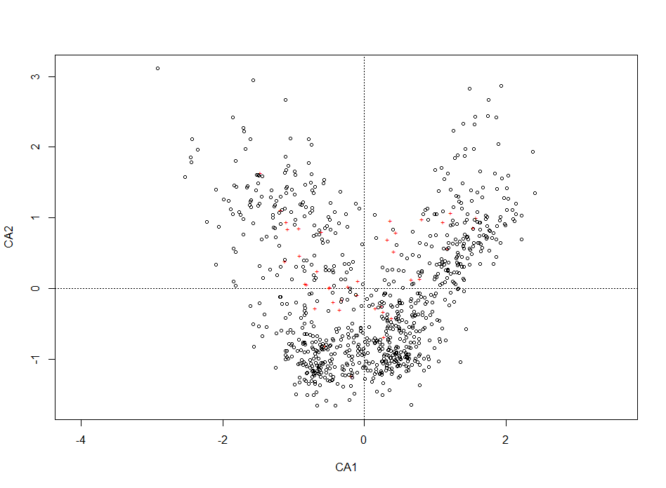
Q2: arctic.env CA plot

Slide 3
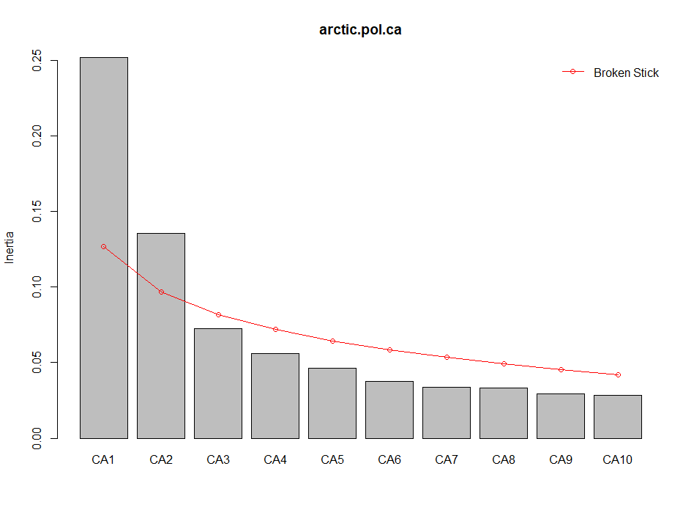
Q2: arctic.env screeplot

Slide 4
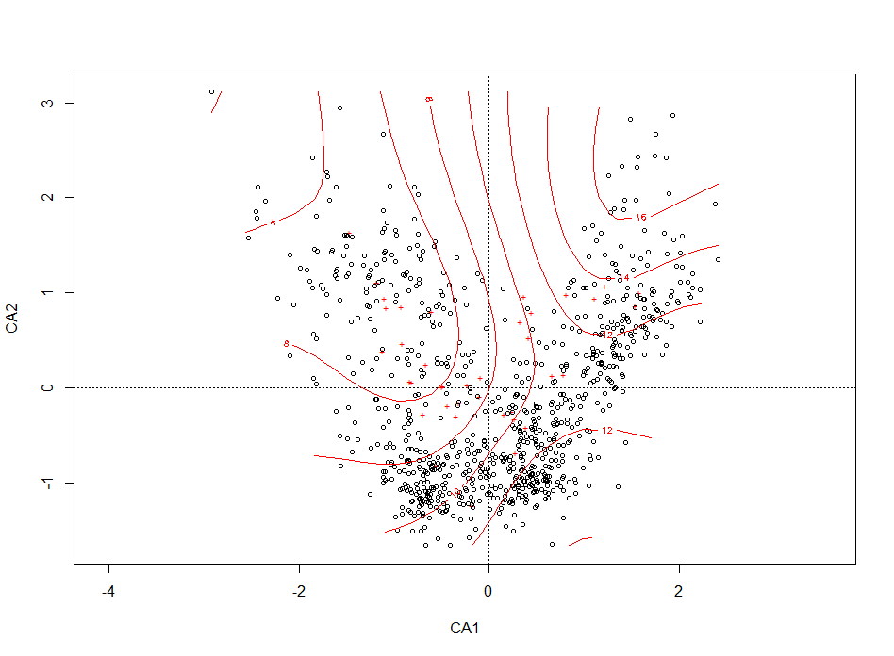
Q2: arctic.env CA plot with ordination surface

Slide 5
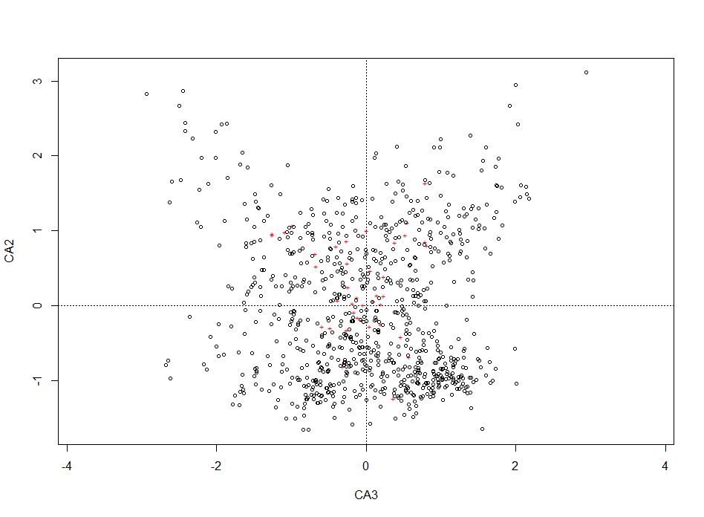
Q2: arctic.env CA2 vs. CA3 plot

Slide 6
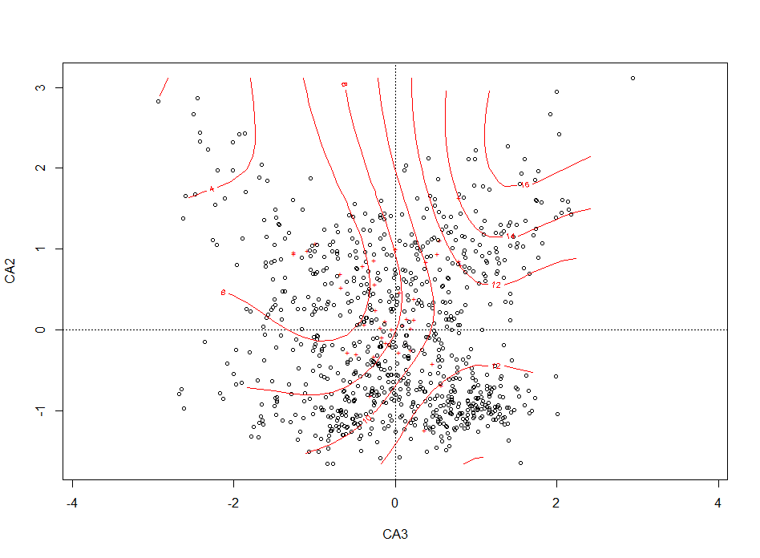
Q2: arctic.env CA2 vs. CA3 plot with ordination surface

Slide 7
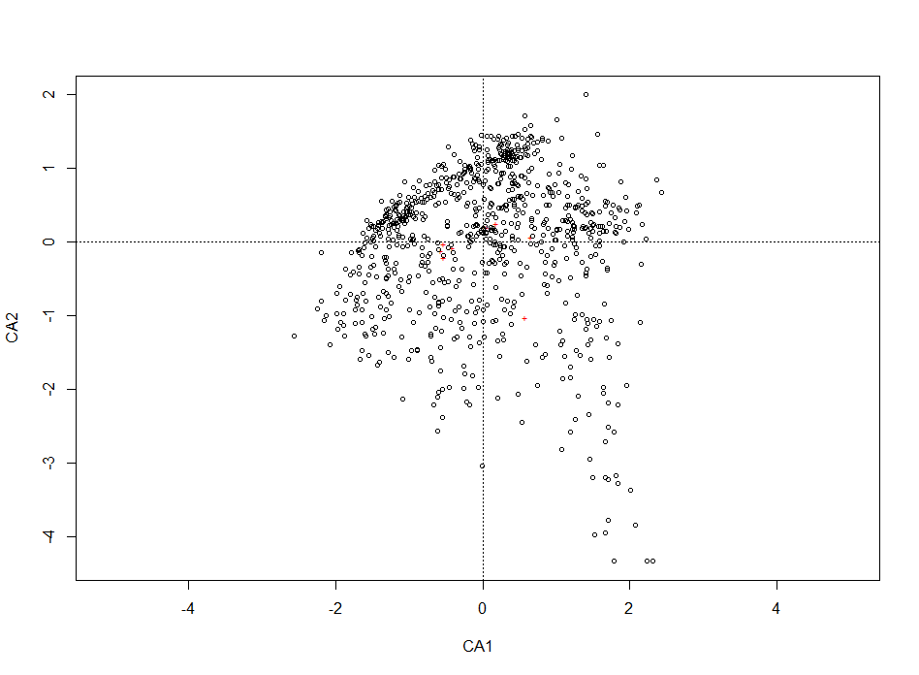
Q2: arctic.env CA plot w/o rares

Slide 8
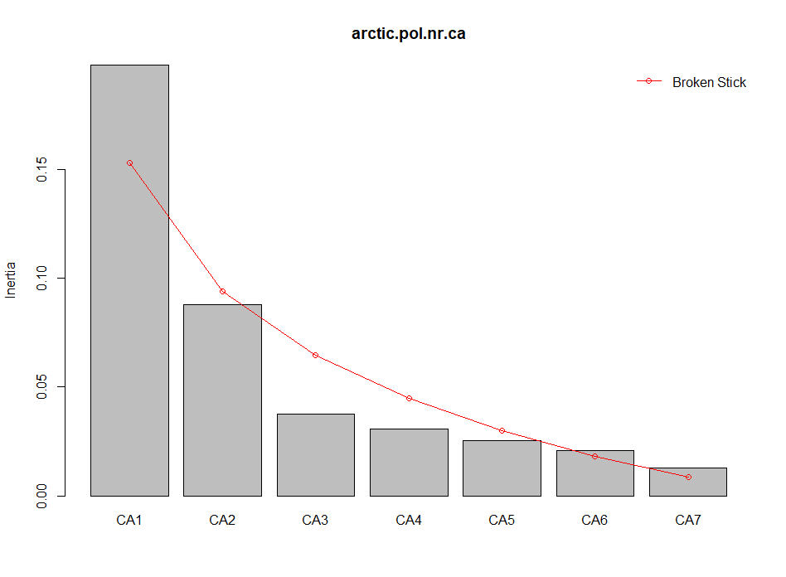
Q2: arctic.env screeplot w/o rares

Slide 9
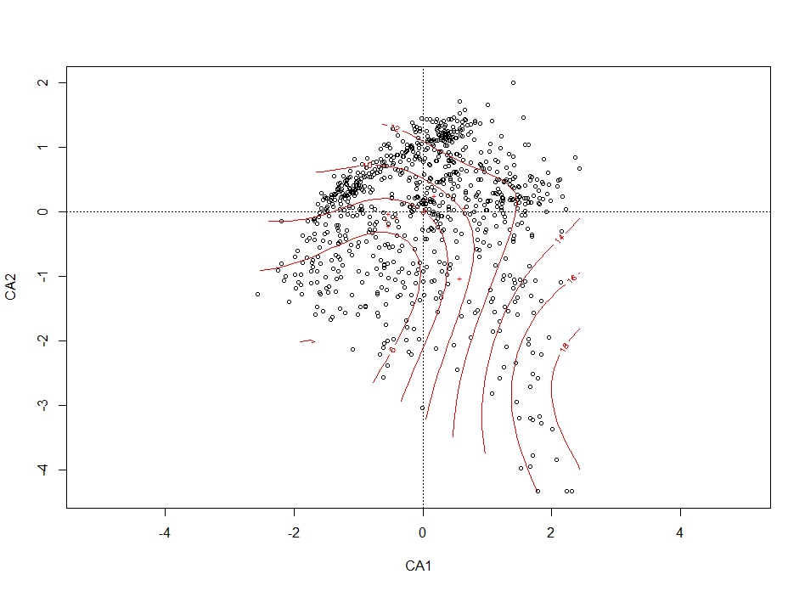
Q2: arctic.env CA plot w/o rares, with ordination surface

Slide 10
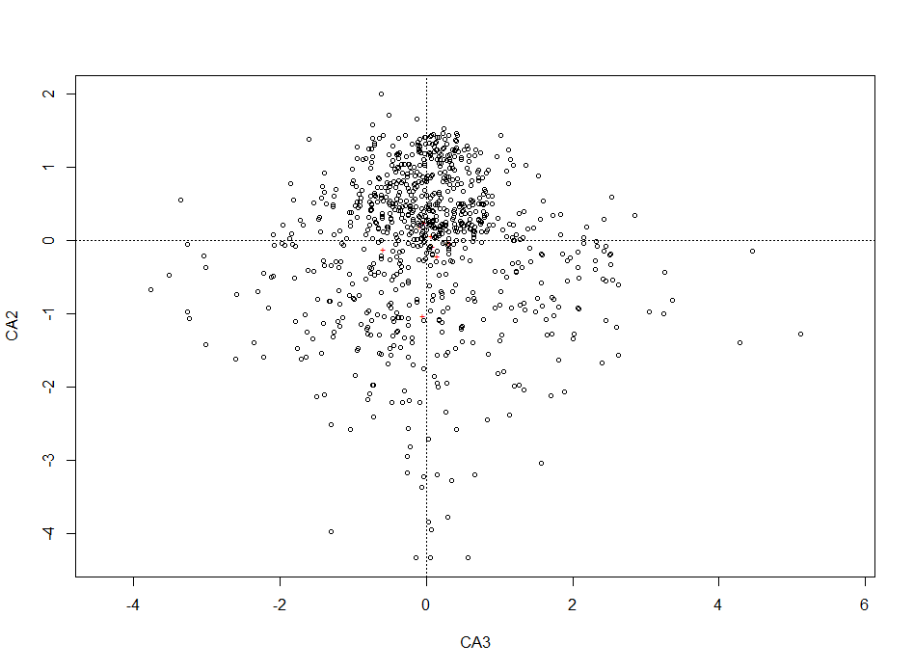
Q2: arctic.env CA2 vs. CA3 plot w/o rares

Slide 11
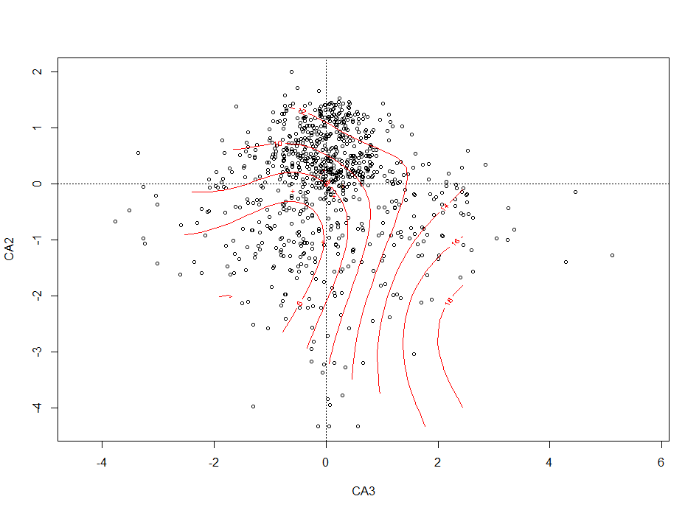
Q2: arctic.env CA2 vs CA3 plot w/o rares, with ordination surface

Slide 12
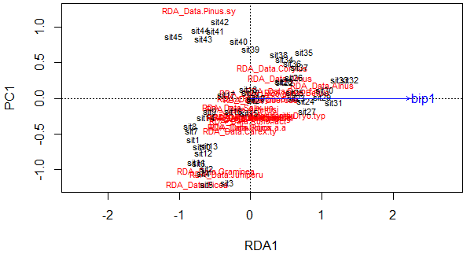
Q4: RDA vs. PCA Norway Pollen Data- Precip constrained

Slide 13
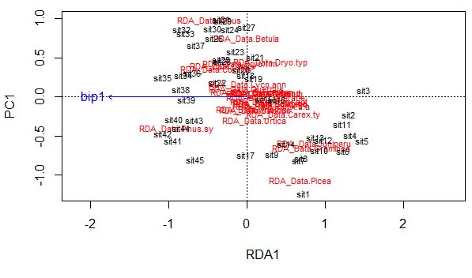
Q4: RDA vs. PCA Norway Pollen Data- Temp constrained

Slide 14
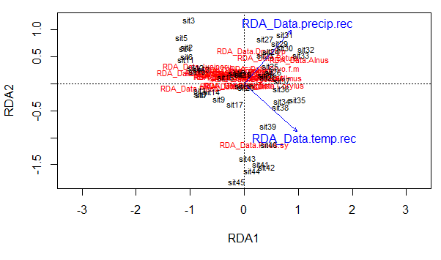
Q4: Norway Pollen Data- Precip and Temp Triplot

Slide 15
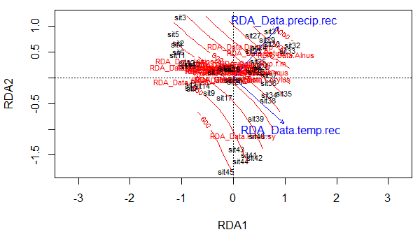
Q4: Norway Pollen Data- Precip and Temp Triplot with Precip Ordination Surface

Slide 16
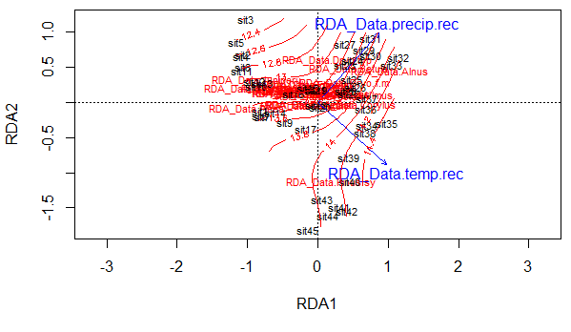
Q4: Norway Pollen Data- Precip and Temp Triplot with Temp Ordination Surface

